Slide 1
Sales & Financial Performance Dashboard

Slide 2
Sales Financial Dataset Summary
This dataset is composed of multiple interconnected sheets providing a comprehensive view of financial operations, structured as follows:
GL (General Ledger)
Records transactional entries with details such as date, amount, territory, and account involved.
Useful for financial statement generation and performance tracking.
COA (Chart of Accounts)
Defines the structure of financial accounts, grouped by categories like Assets, Liabilities, Income, etc.
Provides classification down to sub-account levels for detailed reporting.
Calendar
Time dimension for analysis, breaking down dates into year, quarter, month, and day.
Enables temporal trends and period-based comparisons.
Territory
Maps territory keys to countries and regions.
Supports geographical segmentation of financial data.

Slide 3
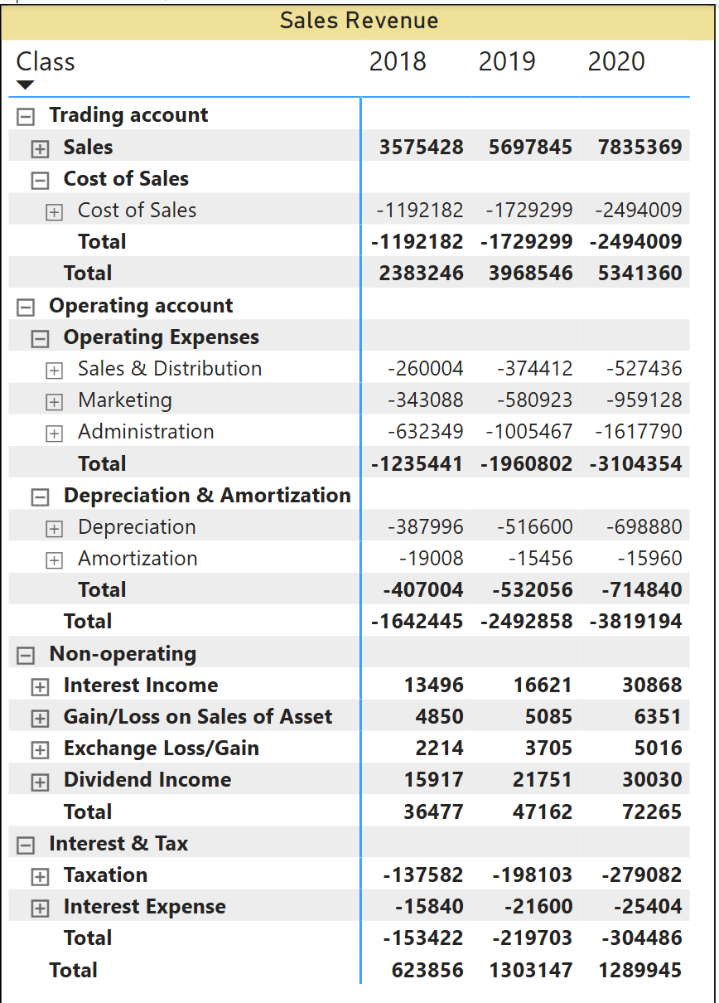
Sales Revenue
Financial Highlights (₹ in lakhs)
Sales Revenue steadily grew:
2018: ₹35.8L → 2019: ₹56.9L → 2020: ₹78.5L
Gross Profit rose consistently:
2018: ₹23.8L → 2020: ₹53.4L
Operating Expenses increased with revenue:
2018: ₹12.3L → 2020: ₹31.0L
Net Profit nearly doubled from 2018 to 2019:
2018: ₹6.2L
2019: ₹13.0L
2020: ₹12.9L
Key Contributors to cost rise:
Marketing & Admin expenses
Higher depreciation

Slide 4
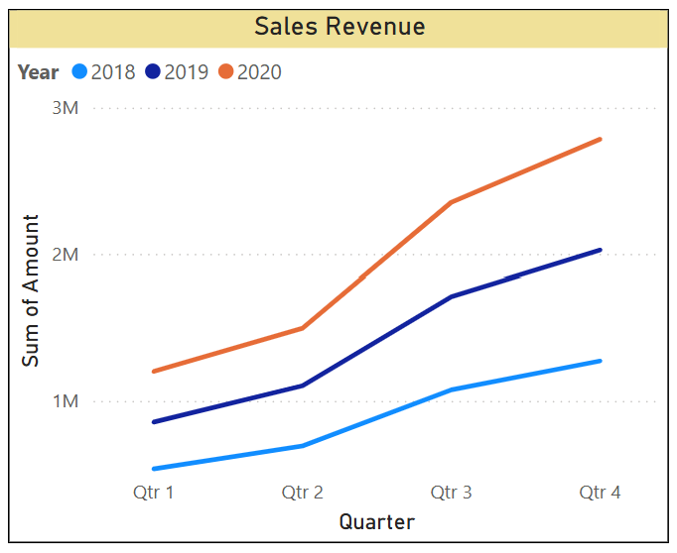
Visual Representation of Sales Revenue
Sales Revenue Trend (2018–2020)
📈 Steady growth observed across all quarters
💼 Strongest revenue recorded in 2020
🔹 2018 < 2019 < 2020 — consistent year-over-year improvement
🚀 Q3 & Q4 of 2020 showed the sharpest rise

Slide 5
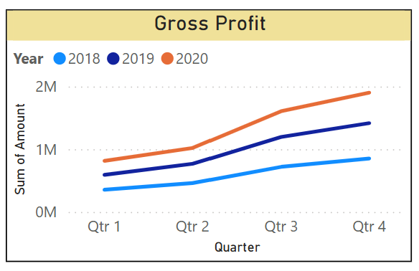
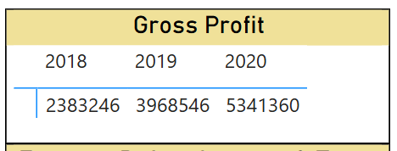
Gross Profit of Sales Revenue
Gross Profit Trend (2018–2020)
📈 Year-on-year growth in gross profit
💰 2020 highest at ₹53.4L, followed by 2019 and 2018
🔹 2018 (₹23.8L) < 2019 (₹39.7L) < 2020 (₹53.4L)
🚀 Strong Q3 & Q4 growth, especially in 2020

Slide 6
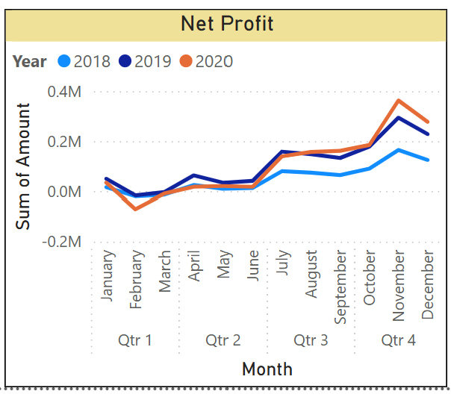
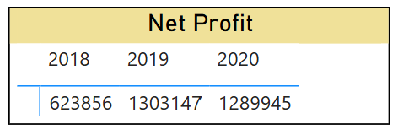
Net Profit of Sales Revenue
Net Profit Trend (2018–2020)
📈 Consistent year-over-year growth in net profit 💼 2019 recorded the highest profit (₹13.03L), 2020 close behind 🔹 2018 < 2020 < 2019 — peak performance in 2019 🚀 Q4 showed the strongest gains across all years

Slide 7
Summary
📊 Sales Revenue (2018–2020)
Steady YoY growth: ₹35.8L (2018) → ₹56.9L (2019) → ₹78.3L (2020)
Qtr-on-Qtr rise across all years with strongest gains in Q3 and Q4
2020 outperformed both prior years in all quarters
💰 Gross Profit
Increased from ₹23.8L (2018) to ₹53.4L (2020)
Margins improved due to better control over cost of sales
Strongest Q4 performance seen in 2020

Slide 8
Summary
📈 Net Profit
Doubled from ₹6.2L (2018) to ₹13L+ (2019), slight dip to ₹12.9L (2020)
Profit dips in Q1 due to seasonal expense spikes
High profitability maintained in Q4 across all years
🔍 Key Drivers of Net Profit (2020)
📉 Operating Expenses: ₹-31L (↑ from 2019)
🏢 Depreciation & Amortization: ₹-7.1L
💸 Interest & Tax: ₹-3L
📈 Non-operating income (Interest, Dividends): ₹72.2K helped cushion profit

Slide 9
Thank You

